Slide 1

VNF Chain Allocation and Management at Data Center Scale
…
Cloud Provider
Tenants
Nodir Kodirov, Sam Bayless, Fabian Ruffy,
Ivan Beschastnikh, Holger Hoos, Alan Hu

Slide 2
Network Functions (NF) are useful and widespread
Security
  Firewall, DDoS protection, DPI
Monitoring
  QoE monitor, Network Stats
Services
  Ad insertion, Transcoder
Network optimization
  NAT, Load-balancer, WAN accelerator
Sherry et al. find # of middleboxes are ≈ to # of L2/L3 devices in enterprise
Sherry et al. Making Middleboxes Someone Else's Problem: Network Processing as a Cloud Service, SIGCOMM'12
Notes:
Approximation symbol

Slide 3
Benefits of Virtualized Network Functions (VNF)
Elasticity
  Quick scale up and down NFs
Fast upgrades
  No need to wait for new hardware
Quick configuration, recovery
  Failover to the backup NF instance
Outsourcing
Sherry et al. Making Middleboxes Someone Else's Problem: Network Processing as a Cloud Service, SIGCOMM’12
Rajagopalan et al., Split/Merge: System Support for Elastic Execution in Virtual Middleboxes, NSDI’13
Martins et al., ClickOS and the Art of Network Function Virtualization, NSDI'14

Slide 4
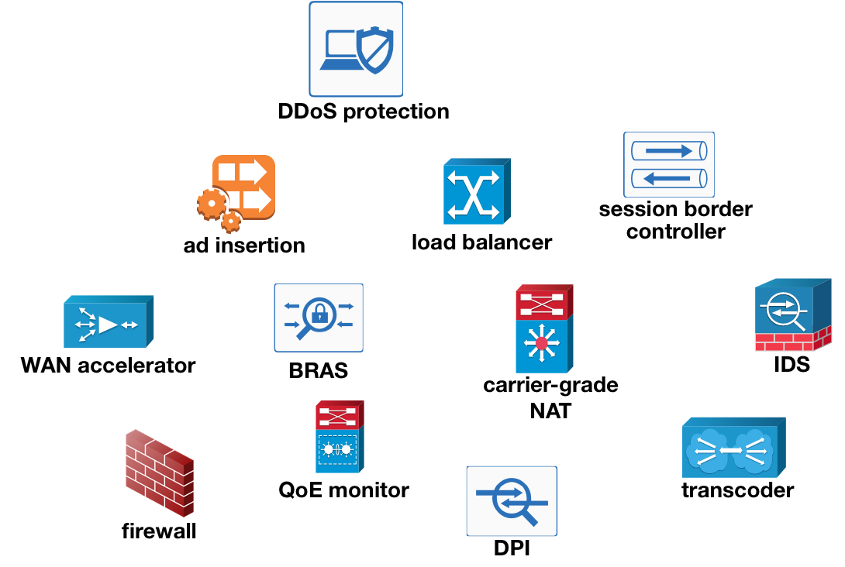
Outsourcing VNFs to the Cloud
Elasticity
  Quick scale up and down NFs
Fast upgrades
  No need to wait for new hardware
Quick configuration, recovery
  Failover to the backup NF instance
Outsourcing
Sherry et al. Making Middleboxes Someone Else's Problem: Network Processing as a Cloud Service, SIGCOMM'12

Slide 5

Outsourcing VNFs to the Cloud
…
chain
Cloud Provider
Tenants

Slide 6
Outsourcing VNF Chains to the Cloud
…
chain
Cloud Provider
Tenants

Slide 7
Challenges of outsourcing VNF Chains
…
chain
Cloud Provider
Tenants

Slide 8
Challenges of outsourcing VNF Chains
How can cloud providers achieve high data center utilization?
How can tenants allocate and manage their VNF chains?
…
…
…
chain
Cloud Provider
Tenants

Slide 9
Challenges of outsourcing VNF Chains
How can cloud providers achieve high data center utilization?
How can tenants allocate and manage their VNF chains?
…
…
…
chain
Cloud Provider
Tenants

Slide 10
Our contributions: API and algorithm
How can cloud providers achieve high data center utilization?
How can tenants allocate and manage their VNF chains?
API to allocate and manage VNF chains
Three algorithms
  implement the API, and
  achieve high data center utilization
Evaluation
  simulate: in data center scale with 1000+ servers
  Daisy: emulate chain management at rack-scale
…
Cloud Provider
Tenants

Slide 11
VNF Chain: six API with use-cases
1
2
NAT
2
FW
1
IDS
1
VPN
2
Initial chain
cid ⟵ allocate-chain(C, bw)
remove-link-bandwidth(a, b, bw, cid)
add-link-bandwidth(a, b, bw, cid)
remove-node(f, cid)
add-node(f, cid)
remove-e2e-bandwidth(cid, bw)
1
1
A graph can be transformed arbitrarily by
manipulating individual nodes and edges.
2
NAT
2
FW
1
IDS
1
VPN
2
3
NAT
3
FW
2
IDS
2
VPN
3
1
IDS’
1
Chain expand
…
Chain scale-out
Element upgrade
Notes:
Takeaway is “expressiveness” of the API. Because it is expressive these 6 API can handle general chain management.

Slide 12
Scale-out beyond single physical resource capacity
1
2
NAT
2
FW
1
IDS
1
VPN
2
Initial chain
cid ⟵ allocate-chain(C, bw)
remove-link-bandwidth(a, b, bw, cid)
add-link-bandwidth(a, b, bw, cid)
remove-node(f, cid)
add-node(f, cid)
remove-e2e-bandwidth(cid, bw)
10
50
NAT
50
FW
40
IDS
40
VPN
50
Chain scale-out

Slide 13
Chain Abstraction: Abstract-Concrete VNF Chains
10
10
Abstract VNF chain
  what tenant requires to allocate
  and operates on
Concrete VNF chain
  cloud provider’s implementation
  of the abstract chain
Chains abstraction advantages
  facilitates high DC utilization
50
40
50
50
40
50
40
50
NAT
FW
40
IDS
VPN
50
NAT
FW
IDS
VPN
Abstract chain (for Tenants)
1
1
NAT
FW
IDS
VPN
5
NAT
FW
IDS
VPN
5
5
4
4
5
5
4
4
5
…
10×
Concrete chains (for Cloud provider)

Slide 14
Our contributions: API and algorithm
How can cloud providers achieve high data center utilization?
How can tenants allocate and manage their VNF chains?
API to allocate and manage VNF chains
Three algorithms
  implement the API, and
  achieve high data center utilization
Evaluation
  simulate: in data center scale with 1000+ servers
  Daisy: emulate chain management at rack-scale
…
Cloud Provider
Tenants

Slide 15
Our contributions: API and algorithm
How can cloud providers achieve high data center utilization?
How can tenants allocate and manage their VNF chains?
API to allocate and manage VNF chains
Three algorithms
  implement the API, and
  achieve high data center utilization
Evaluation
  simulate: in data center scale with 1000+ servers
  Daisy: emulate chain management at rack-scale
…
Cloud Provider
Tenants

Slide 16
Algorithm inputs: DC topology and chain
1
2
NAT
2
FW
1
IDS
1
VPN
2
1/8 core
1/2 GB
3/8 core
1/2 GB
1/2 core
2 GB
1/4 core
1/2 GB
Expected resource consumption per Gbps of traffic
(see the paper for VNF profile generation)
Palkar et al., E2: A Framework for NFV Applications, SOSP’15
Naik et al., NFVPerf: Online performance monitoring and bottleneck detection for NFV, IEEE NFV-SDN 2016.
Nam et al., Probius: Automated Approach for VNF and Service Chain Analysis in Software-Defined NFV, SOSR'18

Slide 17
Algorithms for Chain Allocation and Management
1
2
NAT
2
FW
1
IDS
1
VPN
2
1/8 core
1/2 GB
3/8 core
1/2 GB
1/2 core
2 GB
1/4 core
1/2 GB
Expected resource consumption per Gbps of traffic
(see the paper for VNF profile generation)

Slide 18
Algorithms for Chain Allocation and Management
Random (baseline)
  Consider NFs and servers/switches in random order
  Attempt the above step n times (e.g., n=100)
  Choose the shortest path between chain NFs
1
2
NAT
2
FW
1
IDS
1
VPN
2

Slide 19
Algorithms for Chain Allocation and Management
Random (baseline)
  Consider NFs and servers/switches in random order
  Attempt the above step n times (e.g., n=100)
  Choose the shortest path between chain NFs
NetPack: Random + 3 simple heuristics
  Consider the chain NFs in a topological order
  Re-use the same server when allocating consecutive NFs
  Gradually increase the network scope: rack, cluster, etc.
VNFSolver: how optimal is NetPack?
  Constraint-solver based chain allocation algorithm
  Slow, but complete: finds a solution when one exists
E2
Commercial
Facebook
?
?
?
?
?
?
N
# of allocated chains
NetPack
NetPack
NetPack
NetPack
NetPack
Random
Random
R
R
R
R
4-node
10-node
Palkar et al., E2: A Framework for NFV Applications, SOSP’15
Bayless et al., SAT Modulo Monotonic Theories, AAAI'15

Slide 20
Our contributions: API and algorithm
How can cloud providers achieve high data center utilization?
How can tenants allocate and manage their VNF chains?
API to allocate and manage VNF chains
Three algorithms
  implement the API, and
  achieve high data center utilization
Evaluation
  simulate: in data center scale with 1000+ servers
  Daisy: emulate chain management at rack-scale
…
Cloud Provider
Tenants

Slide 21
Our contributions: API and algorithm
How can cloud providers achieve high data center utilization?
How can tenants allocate and manage their VNF chains?
API to allocate and manage VNF chains
Three algorithms
  implement the API, and
  achieve high data center utilization
Evaluation
  simulate: in data center scale with 1000+ servers
  Daisy: emulate chain management at rack-scale
…
Cloud Provider
Tenants

Slide 22
Evaluation: Objectives
How good is the data center utilization?
  Evaluate Random, NetPack, and VNFSolver
  Consider three different data center topologies
  Use five different VNF chains with varying length (2-10)
How fast is chain allocation?
  Measure time it takes to saturate the data center
Does API reliably implement the use-cases?
  Prototype scale-out and chain upgrade in Daisy
  Use two different racks, two sources of packet traces

Slide 23
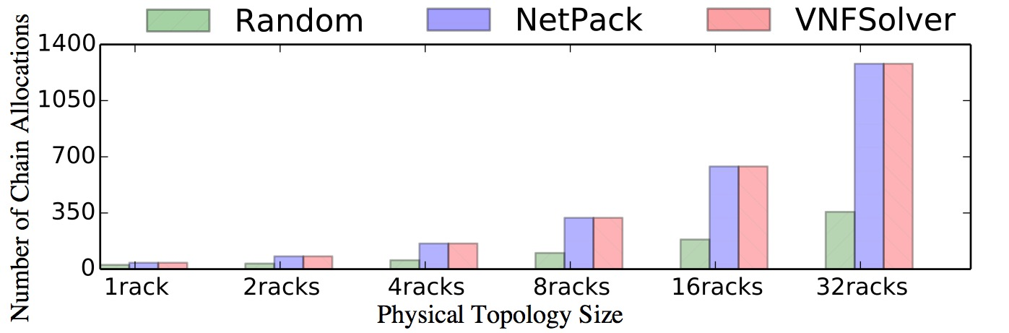
Data center utilization evaluation
NetPack achieves at least 96% of VNFSolver allocations.
Chain allocation time: Random ≲ NetPack ≪ VNFSolver.
1
2
NAT
2
FW
1
IDS
1
VPN
2
Palkar et al., E2: A Framework for NFV Applications, SOSP'15
Notes:
Emphasize: this is a simulation
The commercial and Facebook topologies give qualitatively similar results

Slide 24
NetPack Utilization and Speed
Qualitatively similar results with Facebook and Commercial DC topologies with chains of up to 10 nodes.
(see the paper for details)
NetPack achieves at least 96% of VNFSolver allocations while being 82x faster than VNFSolver (optimal) and only up to
54% slower (per chain) than Random (baseline) on average.
Notes:
Emphasize: this is a simulation
The commercial and Facebook topologies give qualitatively similar results

Slide 25
Feasibility check: can API be implemented?
Daisy builds on Sonata framework
  Mininet to build DC topology
  OVS for switches, and Dockers for NFs
Runs on a single Azure VM
  64 cores, 432 GB RAM
Emulates use-cases and chain arrivals
  scale-out and upgrade use-cases
  continuous arrival of tenant chains in rack-scale
DAISY
mininet
Peuster et al., Sonata NFV SDK, github.com/sonata-nfv/son-emu, 2017
Notes:
Better title for this slide?

Slide 26
VNF Chain use-cases are feasible with narrow API
1
1
2
NAT
2
FW
1
IDS
1
VPN
2
3
NAT
3
FW
2
IDS
2
VPN
3
Initial chain
Chain scale-out
Daisy implements scale-out with no packet drops.___

Slide 27
VNF Chain use-cases are feasible with narrow API
Daisy Contributions
1
1
2
NAT
2
FW
1
IDS
1
VPN
2
3
NAT
3
FW
2
IDS
2
VPN
3
Initial chain
Chain scale-out
Daisy implements scale-out with no packet drops and element upgrade with 1s packet drop at most.
We also emulated continuous chain arrival case where different tenants make chain allocation requests one-by-one.
Daisy implements scale-out with no packet drops.___

Slide 28
Contributions
…
Cloud Provider
Tenants
API with six primitives
  Implements wide-range of chain operations
  Chain abstraction facilitates full DC utilization
NetPack algorithm
  Handles DC-scale allocation with 1000+ servers
  Achieves at least 96% allocations of VNFSolver
  (optimal) while being 82x faster on average
Daisy prototype
  Demonstrates feasibility of API and algorithms
How can tenants allocate and manage their VNF chains?
How can cloud providers achieve high data center utilization?
Thank you!

Slide 30
Backup Slides

Slide 31
Chain Abstraction: Abstract-Concrete VNF Chains
10
Abstract VNF chain
  what tenant requires to allocate
  and operates on
Concrete VNF chain
  cloud provider’s implementation
  of the abstract chain
Chains abstraction advantages
  facilitates high DC utilization
Challenges
  low-latency, packet loss,
  state synchronization, efficiency loss
  (see the paper and ANCS’18 poster)
50
NAT
50
FW
40
IDS
40
VPN
50
Abstract chain (for Tenants)
1
5
NAT
5
FW
4
IDS
4
VPN
5
…
10×
1
5
NAT
5
FW
4
IDS
4
VPN
5
Concrete chains (for Cloud provider)

Slide 32
Topological sort of VNF chain
An example using Kahn’s algorithm
(VPN, NAT, LB, FW3, FW1, FW2, WC, DPI, IPS, GW)
A. B. Kahn, Topological sorting of large networks, Communications of the ACM, 1962
Notes:
Emphasize: this is a simulation
The commercial and Facebook topologies give qualitatively similar results

Slide 33
VNF Chains
Chains (a) and (b) are from OpenBox, (c) and (e) are from E2, and (d) is from Embark.
Bremler-Barr et al., OpenBox: A Software-Defined Framework for Developing, Deploying, and Managing Network Functions, SIGCOMM’16
Palkar et al., E2: A Framework for NFV Applications, SOSP'15
Chang et al., Embark: Securely Outsourcing Middleboxes to the Cloud, NSDI'16
Notes:
Emphasize: this is a simulation
The commercial and Facebook topologies give qualitatively similar results

Slide 34
NetPack: Contribution of each Optimization

Slide 35
VNF Chain use-cases are feasible with narrow API
add-node()
1
add-link-bandwidth()
2
NAT
FW
IDS
VPN
remove-link-bandwidth()
2
1
1
2
remove-node()
1
1
3
NAT
3
FW
2
IDS
2
VPN
3
2
NAT
2
FW
1
IDS2
1
VPN
2
Chain scale-out
Element upgrade
Daisy implements scale-out with no packet drops and element upgrade with 1s packet drop at most (not shown).

Slide 36
Daisy Contributions
1
2
NAT
2
FW
1
IDS
1
VPN
2
VNFSolver allocated 75 concrete chains (687 Mbps)
NetPack allocated 67 concrete chains (633 Mbps)
Random allocated 61 concrete chains (561 Mbps)
(throughput with iperf generated packets is precise)

Slide 37
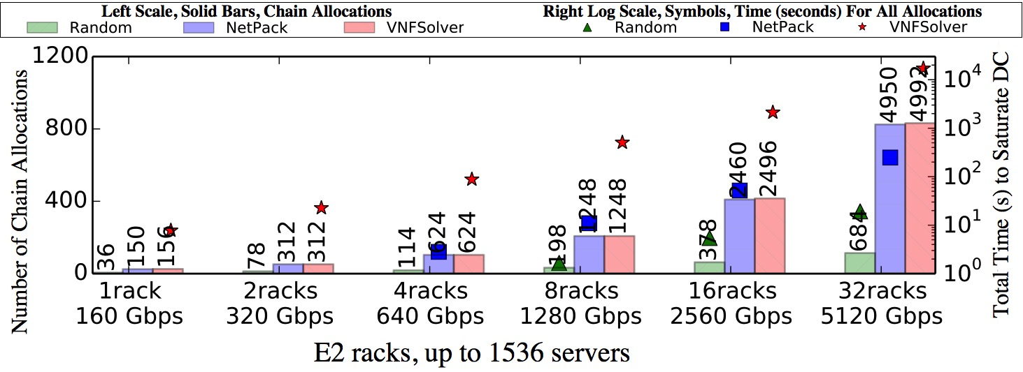
Utilization and Speed on E2 racks
NetPack achieves at least 96% of VNFSolver allocations while being 82x faster than VNFSolver on average.
Palkar et al., E2: A Framework for NFV Applications, SOSP'15
Notes:
Emphasize: this is a simulation
The commercial and Facebook topologies give qualitatively similar results

Slide 38
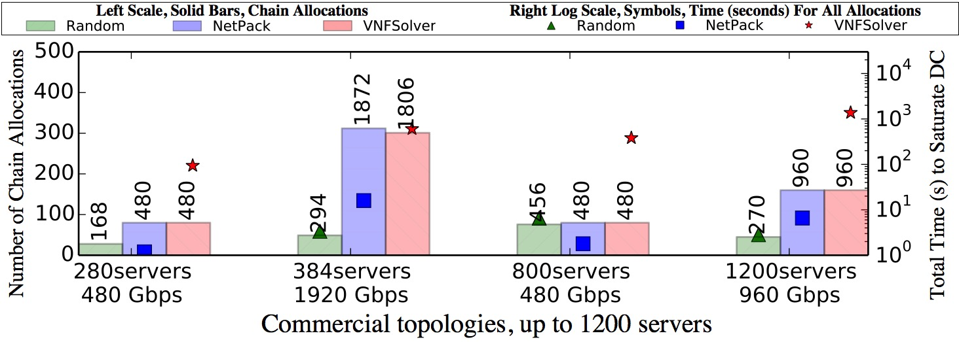
Utilization and Speed on Commercial Topologies
Gives qualitatively similar results, but also reveals a corner case for VNFSolver (-3.65%).

Slide 39
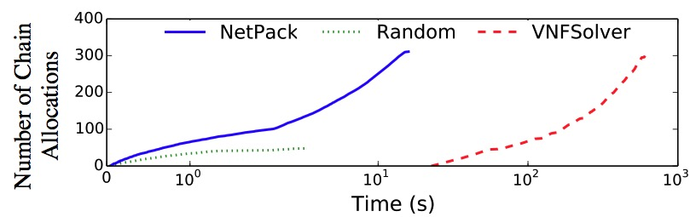
A corner case for VNFSolver
Variance across 10 runs:
Random < 10.4%
NetPack < 0.7%
VNFSolver < 3.7%
Gives qualitatively similar results, but also reveals a corner case for VNFSolver (-3.65%).

Slide 40
Daisy: emulate continuous chain arrival
1
2
NAT
2
FW
1
IDS
1
VPN
2
VNFSolver allocated 75 chains (687 Mbps)
NetPack allocated 67 chains (633 Mbps)
Random allocated 61 chains (561 Mbps)
(throughput with iperf generated packets is precise)

Slide 41
Daisy Contributions
Daisy reliably implements wide-range of use-cases
and handles chain arrival from different tenants.

